Slide 1
HTML,CSS and Bootstrap

Slide 2
Module Design
Cheat Sheet for HTML and CSS
Target web page
Stage 1 : Apply HTML and CSS to create basic page
2
Web development
fundamentals
1
Introduce the Use Case to be completed
Learn Bootstrap fundamentals
Cheat Sheet for Bootstrap
Stage 2 : Add bootstrap layer to enhance experience
5
S/W Requirements
IDE : Visual Studio
Browser: Google Chrome

Slide 3
Web development fundamentals

Slide 4

Web Designer
Design the look and feel of a website (creative side of website)
Decides the layouts, fonts, colors, images etc.
Creates the visual mock-up of website
Rarely does the development of website

Slide 5

Web Programmer
Brings the website mock-up to life on internet (development side of website)
Develops the website and host onto server.
Has web development skills: HTML ,CSS ,JavaScript ,Java , NodeJS , ReactJS etc.
Notes:
Please go through http://www.enest.net/blog/web-designer-vs-web-programmer-vs-web-developer/

Slide 6

Web Site
A collection of web pages which are grouped together and usually connected together in various ways like hyperlinks, buttons etc .
It creates first impression of your business
It can bring business from any part of the world
It reflects your expertise and reputation.

Slide 7


Client Server 2 tier Web Architecture
Typically, when you are browsing the Internet, you will be using Web Browser software such as Chrome, IE, Firefox etc. so computer which is running a browser is called a client, while the machine which is providing Web pages is called a server.
3
A physical machine operates server logic on the user’s request to determine what to send back
1
2
User enters URL in the browser
HTTP request is submitted to that URL’s corresponding server
Client
HTTP response is returned to the user (client) in a form of HTML,JSON or other formats
User receives the response in the form of HTML pager which renders in the browser window
Server
4
5
Notes:
Reference: https://teaching.shu.ac.uk/aces/rh1/de/web_based_systems_architectures_1_tutorial.htm

Slide 8
Introducing the Use Case

Slide 9

Build below web page using HTML and CSS
Notes:
To build this we should have knowledge of HTML, CSS, JS and Bootstrap

Slide 10
Cheat Sheet references
Cheat Sheet for HTML : HTML Cheat Sheet.doc
Cheat Sheet for CSS: CSS Cheat Sheet.doc

Slide 11
Bootstrap fundamentals

Slide 12

What is Responsive web design
Responsive web design is about creating web sites which automatically adjust themselves to look good on all devices, from small phones to large desktops.
Example: www.getbootstrap.com

Slide 13
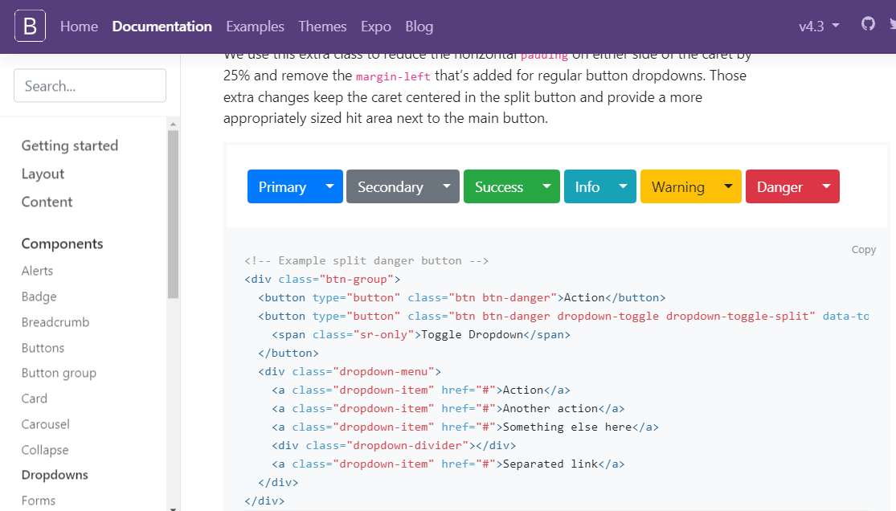
What is Bootstrap
Bootstrap is an open source front-end framework developed by Twitter for faster and easier web development
Bootstrap includes HTML and CSS based design templates for typography, forms, buttons, tables, navigation, modals, image carousels, dropdown and many other, as well as optional JavaScript plugins.
Bootstrap also gives you the ability to easily create responsive designs
Current version of Bootstrap is 4.3.1 released on February 2019.
Official website is http://getbootstrap.com

Slide 14
Advantages of Bootstrap
Easy to use: Anybody with just basic knowledge of HTML and CSS can start using Bootstrap
Responsive features: Bootstrap's responsive CSS adjusts to phones, tablets, and desktops
Mobile-first approach: Bootstrap 3 onwards mobile-first styles are part of the core framework
Browser compatibility: Bootstrap is compatible with all modern browsers (Chrome, Firefox, Internet Explorer, Edge, Safari, and Opera)

Slide 15
Prerequisite
There are three ways to start using Bootstrap on your own web site:
Download Bootstrap from getbootstrap.com
Download using NPM
Include Bootstrap from a CDN (Content Delivery Network)

Slide 16
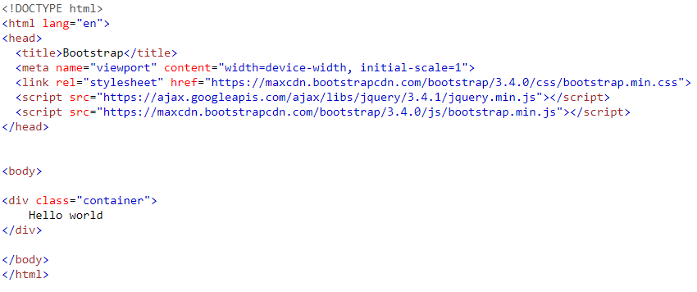

Hello World page using Bootstrap

Slide 17
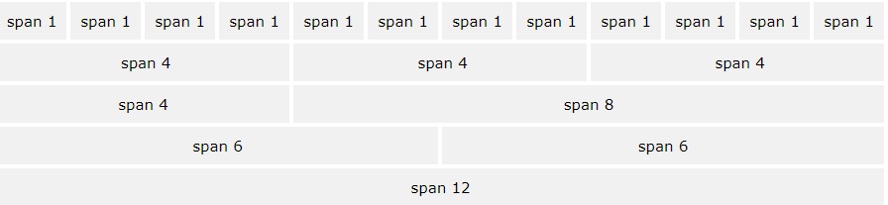
Bootstrap Grid System
Bootstrap's grid system allows up to 12 columns across the page.
Bootstrap's grid system is responsive, and the columns will re-arrange depending on the screen size.
Notes:
Bootstrap's grid system allows up to 12 columns across the page.
Bootstrap's grid system is responsive, and the columns will re-arrange depending on the screen size: On a big screen it might look better with the content organized in three columns, but on a small screen it would be better if the content items were stacked on top of each other.

Slide 18
Grid System Classes
The Bootstrap 3 grid system has four classes:
The classes above can be combined to create more dynamic and flexible layouts.
Tip: Each class scales up, so if you wish to set the same widths for sm and md, you only need to specify sm.
Class | Device | Width
.col-sm | Phones | width<768px
.col-md | Laptops | 768px<= width<992px
.col-lg | Desktops | 992px<=width<1200px
.col-xl | Smart TV | width >=1200px

Slide 19
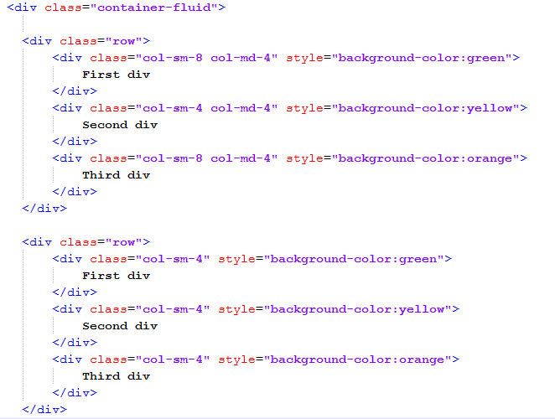
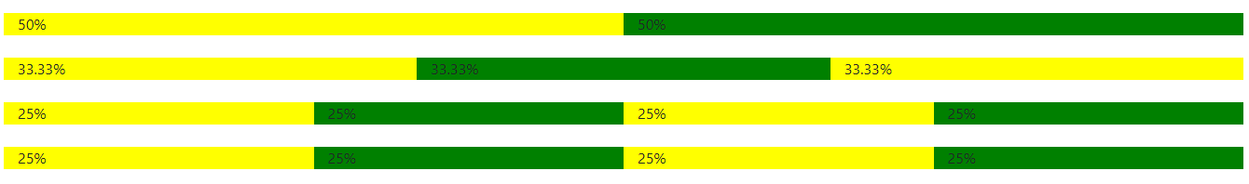
Basic Grid Structure

Slide 20
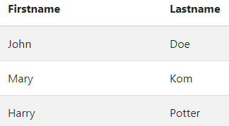
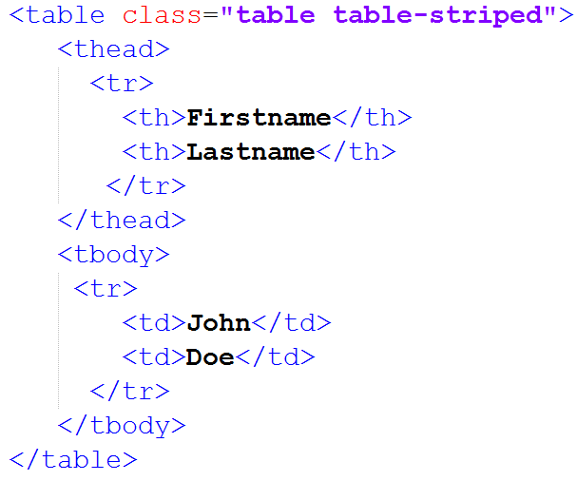
Table
The .table class adds basic styling to a table: A basic Bootstrap table has a light padding and only horizontal dividers.
The .table-striped class adds zebra-stripes to a table.
The .table-bordered class adds borders on all sides of the table and cells.
The .table-hover class adds a hover effect (grey background color) on table rows.
The .table-condensed class makes a table more compact by cutting cell padding in half.

Slide 21

Buttons
To achieve the different background color for button, Bootstrap has the following classes.
  .btn
  .btn-default
  .btn-primary
  .btn-success
  .btn-info
  .btn-warning
  .btn-danger
  .btn-link
Bootstrap provides different button sizes. The classes that define the different sizes are:
  .btn-lg
  .btn-md
  .btn-sm
  .btn-xs

Slide 22
Bootstrap Forms
Bootstrap provides three types of form layouts:
Vertical form (this is default)
Horizontal form
Inline form
Standard rules for all three form layouts:
Wrap labels and form controls in <div class="form-group"> (needed for optimum spacing)
Add class .form-control to all textual <input>, <textarea>, and <select>elements
All textual <input>, <textarea>, and <select> elements with class .form-control have a width of 100%.

Slide 23
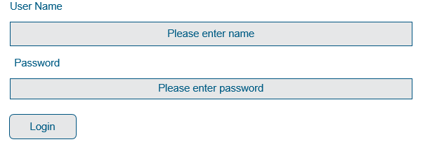

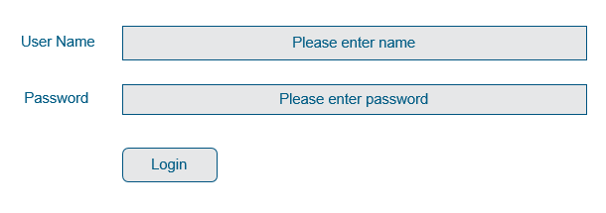
Types of Bootstrap Forms
Vertical Form (default)
Inline Form
Horizontal Form

Slide 24
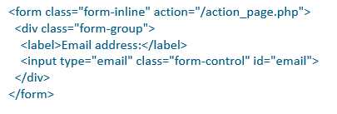
Bootstrap Inline Forms
In an inline form, all of the elements are inline, left-aligned, and the labels are alongside.
Note: This only applies to forms within viewports that are at least 768px wide!
Additional rule for an inline form:
Add class .form-inline to the <form> element

Slide 25
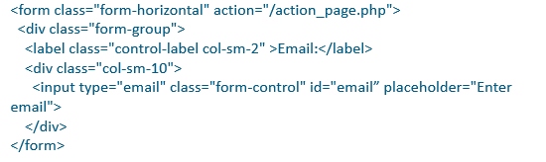
Bootstrap Horizontal Forms
A horizontal form means that the labels are aligned next to the input field (horizontal) on large and medium screens. On small screens (767px and below), it will transform to a vertical form (labels are placed on top of each input).
Additional rules for a horizontal form:
Add class .form-horizontal to the <form> element
Add class .control-label to all <label> elements

Slide 26
Enhance web page using bootstrap

Slide 27
Make the web page responsive using bootstrap
Notes:
To build this we should have knowledge of HTML, CSS, JS and Bootstrap

Slide 28
Cheat Sheet references
Cheat Sheet for bootstrap : bootstrap-3-cheat-sheet.pdf

Slide 29
Thank You

Slide 30
Appendix

Slide 31
What is HTML
HTML is the standard markup language for creating Web pages.
HTML stands for Hyper Text Markup Language
HTML describes the structure of Web pages using markup
HTML elements are represented by tags
HTML tags label pieces of content such as "heading", "paragraph", "table", and so on
Browsers do not display the HTML tags, but use them to render the content of the page

Slide 32
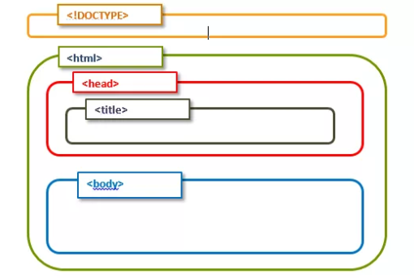
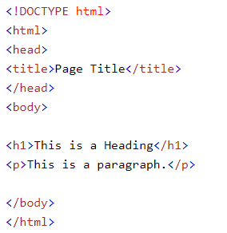
HTML Template

Slide 33
Main categories of elements
  Block level elements : <div>, <p>,<h1> to <h6>, <form>, <table> etc.
  Inline elements: <img>, <a>, <span>, <input> etc.
Notes:
Block level-A block-level element always starts on a new line and takes up the full width available (stretches out to the left and right as far as it can). Ex: <div>, <p>,all headings, <form>, <table> etc.
Inline elements: An inline element does not start on a new line and only takes up as much width as necessary.. Ex: <img>, <a>, <span>, <input> etc.

Slide 34

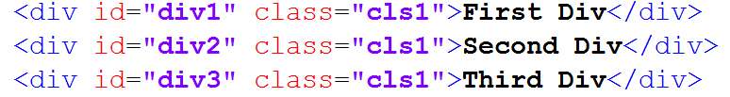
Attributes
Attributes are something which give the additional information of the element. Ex. name, width, height, alt, title, id, class etc.
The id and class attributes: id attribute is used to uniquely identify any element and class is to create a group of elements.
Unique id attribute can be refereed to single person in a class but class attribute is going to be same for all persons belonging to the class.

Slide 35
Types of elements
Empty elements (<br/>)
Nesting elements ( <p> This is my <b>element</b>)
Headings (h1 to h6)
Paragraphs (<p>)
Lists ( ordered (<ol>) and unordered (<ul>) )
Tables (<table>, <tr>, <td>, <th>)
Images (<img>)
Links (<a>)
Text formating (<i>,<u>,<b>,<strong>,<em>)

Slide 36
List of elements contained inside a form
Text Box (Single row)
Radio Button (Single selection)
Check Box (Multiple selection)
Drop down (Multiple selection)
Text area (Multiple rows)
Click button
Submit button
Reset button

Slide 37
Form elements
S No. | Type | Code
1 | Text Box | <input type="text" name="name" value=“John"/>
2 | Radio Button | <input type="radio" name="gender" value="M">Male</input>
3 | CheckBox | <input type="checkbox" name="technology" value="Tech1">HTML</input>
4 | textarea | <textarea rows=“2” cols=“2” name="address"></textarea>

Slide 38
Form elements cont…
S No. | Type | Code
5 | Drop Down | <select name="cities"> <option value="BGL">Bangalore</option> <option value="MYR">Mysore</option </select>
6 | Click Button | <input type="button" value="Click Me"/>
7 | Submit button | <input type="Submit"/>
8 | Reset Button | <input type=“Reset"/>

Slide 39
Form attributes
S No. | Type | Code
1 | size | Changes the width of textboxes
2 | maxlength | maximum no of chars entered in textbox
3 | minlength | minimum no of chars entered in textbox
4 | placeholder | display placeholder value
5 | checked | makes checkboxes or radio buttons to be checked by default
6 | selected | makes one option of dropdown selected by default

Slide 40
Form attributes cont…
S No. | Type | Code
7 | multiple | allows to select multiple values from drop down
8 | readonly | data is going to be processed
9 | disabled | data is not going to be processed
10 | action | defines the action to be performed when the form is submitted and If the action attribute is omitted, the action is set to the current page.
11 | method | specifies the HTTP method (GET or POST) to be used when submitting the form data
12 | target | specifies if the submitted result will open in a new browser tab or in the current window.

Slide 41
get vs post
Get | Post
Appends form-data into the URL in name/value pairs | The POST method does not display the submitted form data in the page address field.
The length of a URL is limited (about 3000 characters) | POST has no size limitations, and can be used to send large amounts of data.
Never use GET to send sensitive data! (will be visible in the URL) | Always use POST if the form data contains sensitive or personal information.
Useful for form submissions where a user want to bookmark the result | Form submissions with POST cannot be bookmarked
GET is better for non-secure data, like query strings in Google | POST is better for secure data, like password

Slide 42
HTML5 Forms – Input Types
S No. | Type | Description
1 | color | used for input fields that should contain a color.
2 | date | used for input fields that should contain a date.
3 | datetime-local | specifies a date and time input field, with no time zone.
4 | time | allows the user to select a time (no time zone).

Slide 43
HTML5 Forms – Input Types cont…
S No. | Type | Description
5 | week | allows the user to select a week and year.
6 | month | allows the user to select a month and year.
7 | email | used for input fields that should contain an e-mail address.
8 | number | defines a numeric input field.
9 | range | defines a control for entering a number whose exact value is not important (like a slider control). Default range is 0 to 100. However, you can set restrictions on what numbers are accepted with the min, max, and step attributes.

Slide 44
HTML5 Forms – Attributes
S No. | Type | Description
1 | autofocus | specifies that the input field should automatically get focus when the page loads.
2 | autocomplete | When autocomplete is on, the browser automatically completes the input values based on values that the user has entered before.
3 | placeholder | specifies a hint that describes the expected value of an input field (a sample value or a short description of the format).
4 | required | specifies that an input field must be filled out before submitting the form.
5 | pattern | specifies a regular expression that the <input> element's value is checked against before submitting form

Slide 45
HTML5 Forms – Attributes Cont…
S No. | Type | Code
6 | multiple | specifies that the user is allowed to enter more than one value in the <input> element. The multiple attribute works with the following input types: email, and file.
7 | list | refers to a <datalist> element that contains pre-defined options for an <input> element.
8 | height and width attributes | specify the height and width of an <input type="image"> element.
9 | step | specifies the legal number intervals for an <input> element.
10 | min and max | specify the minimum and maximum values for an <input> element.

Slide 46
HTML5 forms - Pattern attribute
Specifies a regular expression that the input value is checked against before submitting the form.
Example 1: Entered name can only have alphabets.
pattern= “[A-Za-z]+”
Example 2: Entered phone no can only have numbers of 10 digits.
pattern =“[7-9]{1}[0-9]{9}”

Slide 47
HTML5 Forms – Pattern Attribute
S No. | Type | Code
1 | [0-9] | Find any of the digits between the brackets
2 | [a-z] | Find any of the characters between the brackets
3 | [0-9a-z] | Find any of the alphanumeric characters (small letters)between the brackets
4 | [0-9a-zA-Z] | Find any of the alphanumeric characters between the brackets
5 | [abc] | Find any of the characters between the brackets
6 | [0-9*$] | Find any of the digits and special chars (*$)between the brackets

Slide 48
HTML5 Forms – pattern quantifiers
S. No. | Type | Description
1 | [0-9]+ | Matches any string that contains at least one digit
2 | [0-9]* | Matches any string that contains zero or more occurrences of n
3 | [0-9]? | Matches any string that contains zero or one occurrences of n
4 | [0-9]{3} | Matches any string that contains exactly 3 occurrences of n
5 | [0-9]{3,} | Matches any string that contains minimum 3 occurrences of n
6 | [0-9]{3,6} | Matches any string that contains minimum 3 occurrences of n and max 6 occurrences

Slide 49
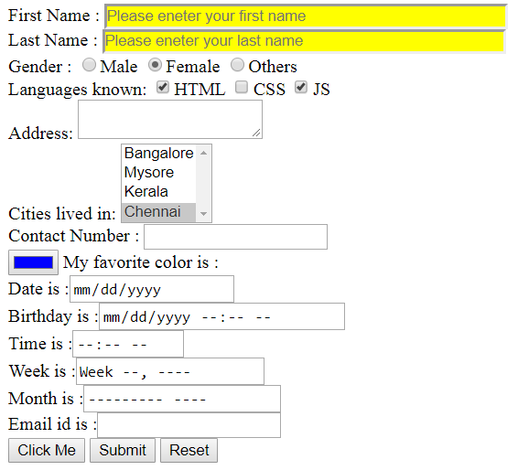
Hands-on for forms
Design the page using HTML5.
Validate first name (only alphabets), last name (only alphabets), contact number(10 digits) and email-id.
Make sure all the fields are required.
Once user submits the page, the new page should open saying “Welcome User”. Try http method as get and post also

Slide 50
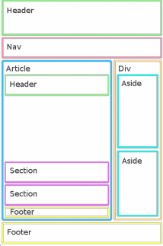
HTML5 Semantic elements
Semantic elements = elements with a meaning.
<article>
<aside>
<details>
<figcaption>
<figure>
<footer>
<header>
<main>
<mark>
<nav>
<section>
<summary>
<time>

Slide 51
What is CSS
CSS stands for Cascading Style Sheets
CSS describes how HTML elements are to be displayed on screen, paper, or in other media
CSS saves a lot of work. It can control the layout of multiple web pages all at once
External stylesheets are stored in CSS files

Slide 52
Selectors
Selectors are something using which we can select the HTML elements.
Below are different types of selectors.
Element Selector : p {color:red;}
Class Selector : .c1{color:red;}
Id Selector : #id1{color:red;}
Universal Selector : # {color:red;}

Slide 53
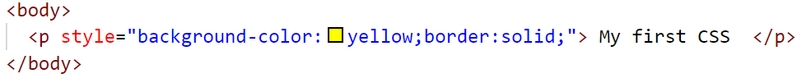
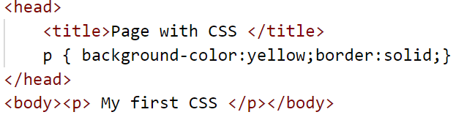
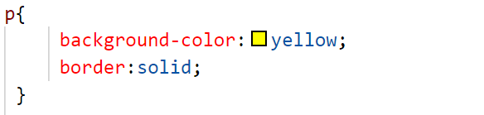
Types of Styling
Inline Styling are CSS declarations that affect one element only, contained within a style attribute.
Internal Styling is where you don't have an external CSS file, but instead place your CSS inside a <style> element, contained inside the HTML head.
An external stylesheet is when you have your CSS written in a separate file with a .css extension, and you reference it from an HTML <link> element.

Slide 54

CSS Box Model
All HTML elements can be considered as boxes. In CSS, the term "box model" is used when talking about design and layout.
Notes:
The CSS box model is essentially a box that wraps around every HTML element. It consists of: margins, borders, padding, and the actual content. The image below illustrates the box model:
Explanation of the different parts:
Content - The content of the box, where text and images appear
Padding - Clears an area around the content. The padding is transparent
Border - A border that goes around the padding and content
Margin - Clears an area outside the border. The margin is transparent
Important: When you set the width and height properties of an element with CSS, you just set the width and height of the content area. To calculate the full size of an element, you must also add padding, borders and margins.
The total width of an element should be calculated like this:
Total element width = width + left padding + right padding + left border + right border + left margin + right margin
The total height of an element should be calculated like this:
Total element height = height + top padding + bottom padding + top border + bottom border + top margin + bottom margin

Slide 55
Font property
The CSS font properties define the font family, boldness, size, and the style of a text.
font-family: "Times New Roman", Times, serif;
font-style : normal| italic| oblique;
font-size: 10px| 10%;
font-weight: normal | bold| 100-900;
font-variant: normal | small-caps;

Slide 56

Border property
The CSS border properties allow you to specify the style, width, and color of an element's border.
CSS border properties:
border-width: 2px;
border-style: solid;
border-color: red;
Notes:
The width can be set as a specific size (in px, pt, cm, em, etc) or by using one of the three pre-defined values: thin, medium, or thick
The color can be set by:
name - specify a color name, like "red"
Hex - specify a hex value, like "#ff0000"
RGB - specify a RGB value, like "rgb(255,0,0)"
Transparent
The border-style property specifies what kind of border to display.
dotted - Defines a dotted border
dashed - Defines a dashed border
solid - Defines a solid border
double - Defines a double border
groove - Defines a 3D grooved border. The effect depends on the border-color value
ridge - Defines a 3D ridged border. The effect depends on the border-color value
inset - Defines a 3D inset border. The effect depends on the border-color value
outset - Defines a 3D outset border. The effect depends on the border-color value
none - Defines no border
hidden - Defines a hidden border

Slide 57
Display property
The display property is the most important CSS property for controlling layout. The display property specifies if/how an element is displayed.
The possible values of display are:
Inline
block
none
inline-block
Notes:
Inline - Displays an element as an inline element (like <span>). Any height and width properties will have no effect
block- Displays an element as a block element (like <p>). It starts on a new line, and takes up the whole width
none - The element is completely removed
inline-block - Displays an element as an inline-level block container. The element itself is formatted as an inline element, but you can apply height and width values.

Slide 58
Position property
The position property specifies the type of positioning method used for an element. Elements are then positioned using the top, bottom, left, and right properties. However, these properties will not work unless the position property is set first.
There are four different position values:
Static (default)
Relative
Fixed
Absolute
Notes:
Static- HTML elements are positioned static by default . Static positioned elements are not affected by the top, bottom, left, and right properties. It is always positioned according to the normal flow of the page.
Relative : is positioned relative to its normal position.
Setting the top, right, bottom, and left properties of a relatively-positioned element will cause it to be adjusted away from its normal position. Other content will not be adjusted to fit into any gap left by the element.
Fixed : is positioned relative to the viewport, which means it always stays in the same place even if the page is scrolled. The top, right, bottom, and left properties are used to position the element.
Absolute: is positioned relative to the nearest positioned ancestor (instead of positioned relative to the viewport, like fixed).

Slide 59
Combinators
A combinator is something that explains the relationship between the selectors.
A CSS selector can contain more than one simple selector. Between the simple selectors, we can include a combinator.
There are four different combinators in CSS:
descendant selector (space) : div p {}
child selector (>): div >p { }
adjacent sibling selector (+): div+p {}
general sibling selector (~): div~p {}
Notes:
descendant selector (space) : The descendant selector matches all elements that are descendants of a specified element.
The following example selects all <p> elements inside <div> elements: div p {}
child selector (>): The child selector selects all elements that are the immediate children of a specified element.
The following example selects all <p> elements that are immediate children of a <div> element : div >p { }
adjacent sibling selector (+): The adjacent sibling selector selects all elements that are the adjacent siblings of a specified element.
Sibling elements must have the same parent element, and "adjacent" means "immediately following".
The following example selects all <p> elements that are placed immediately after <div> elements: div+p {}
general sibling selector (~): The general sibling selector selects all elements that are siblings of a specified element.
The following example selects all <p> elements that are siblings of <div> elements: div~p {}

